Slide 1
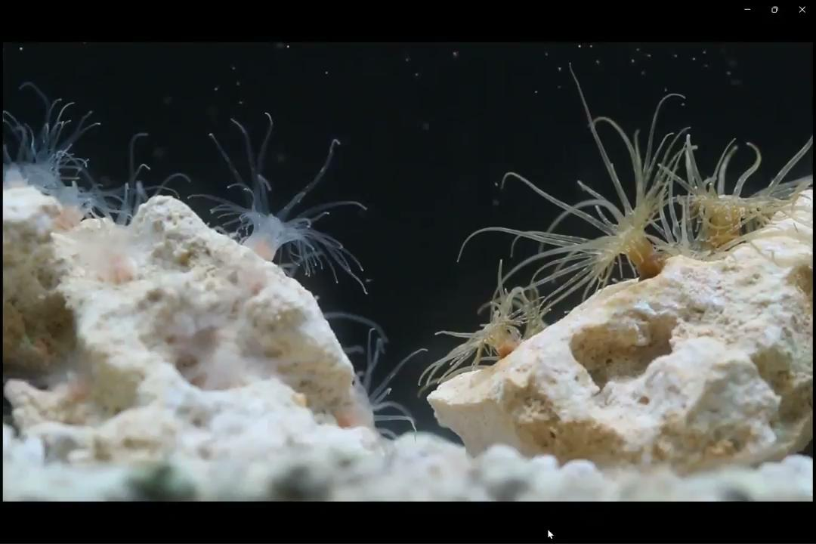
Early Stage Development of Aiptasia Pedal Lacerates

Slide 2
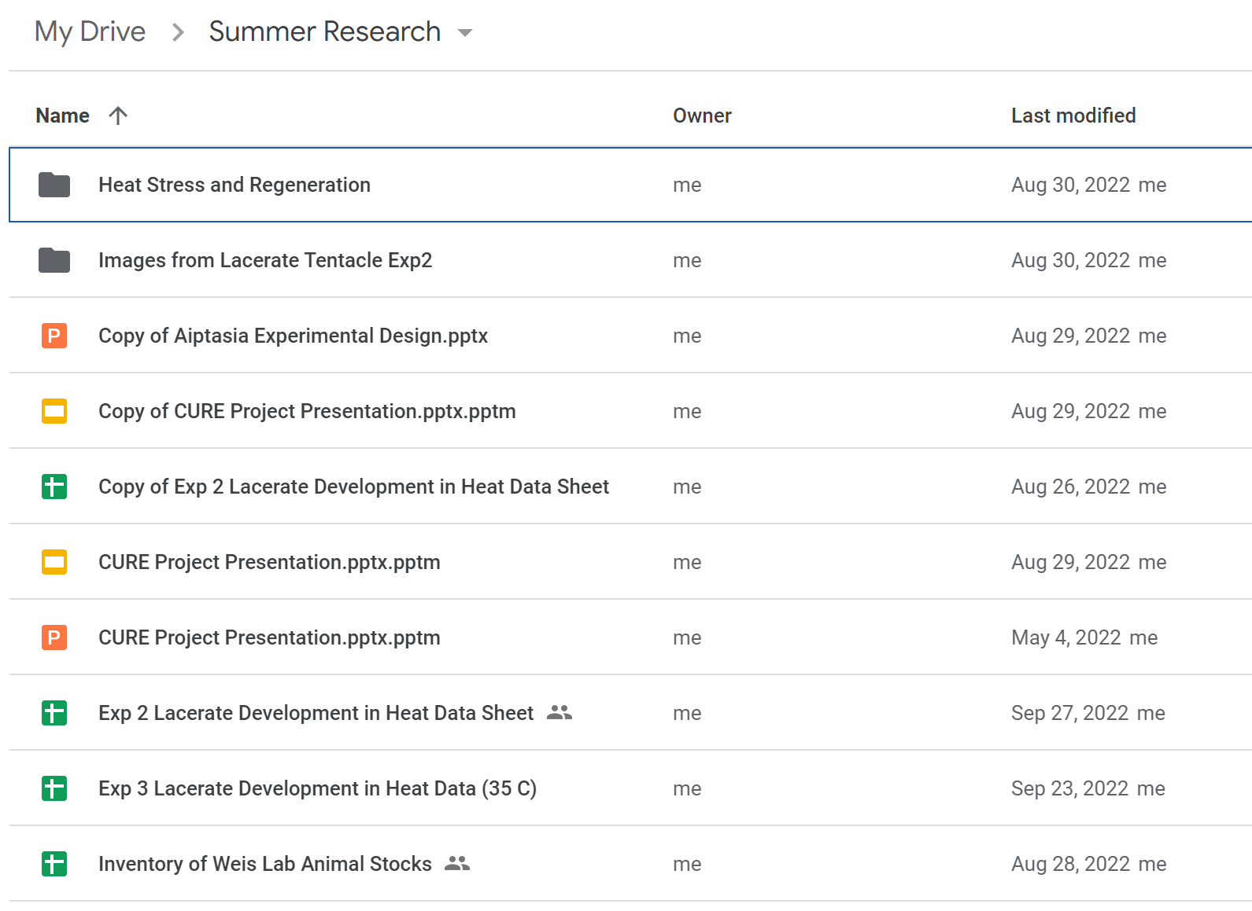
My Background
No experience for data organization or project management
Never worked with a large data set beyond some analysis on R
Reason for taking this course:
Familiarize myself with data organization
Learn best practices in project management especially when collaborating with other
Create an efficient and reproducible workflow from my data set

Slide 3
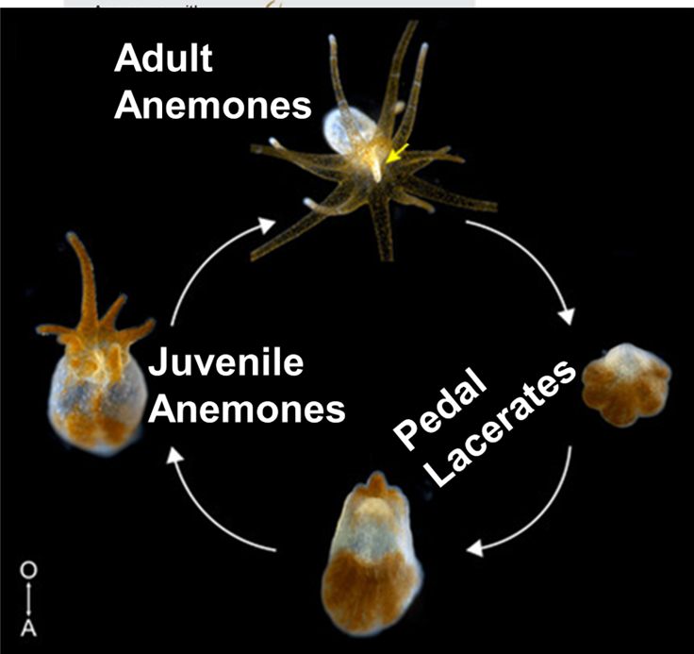
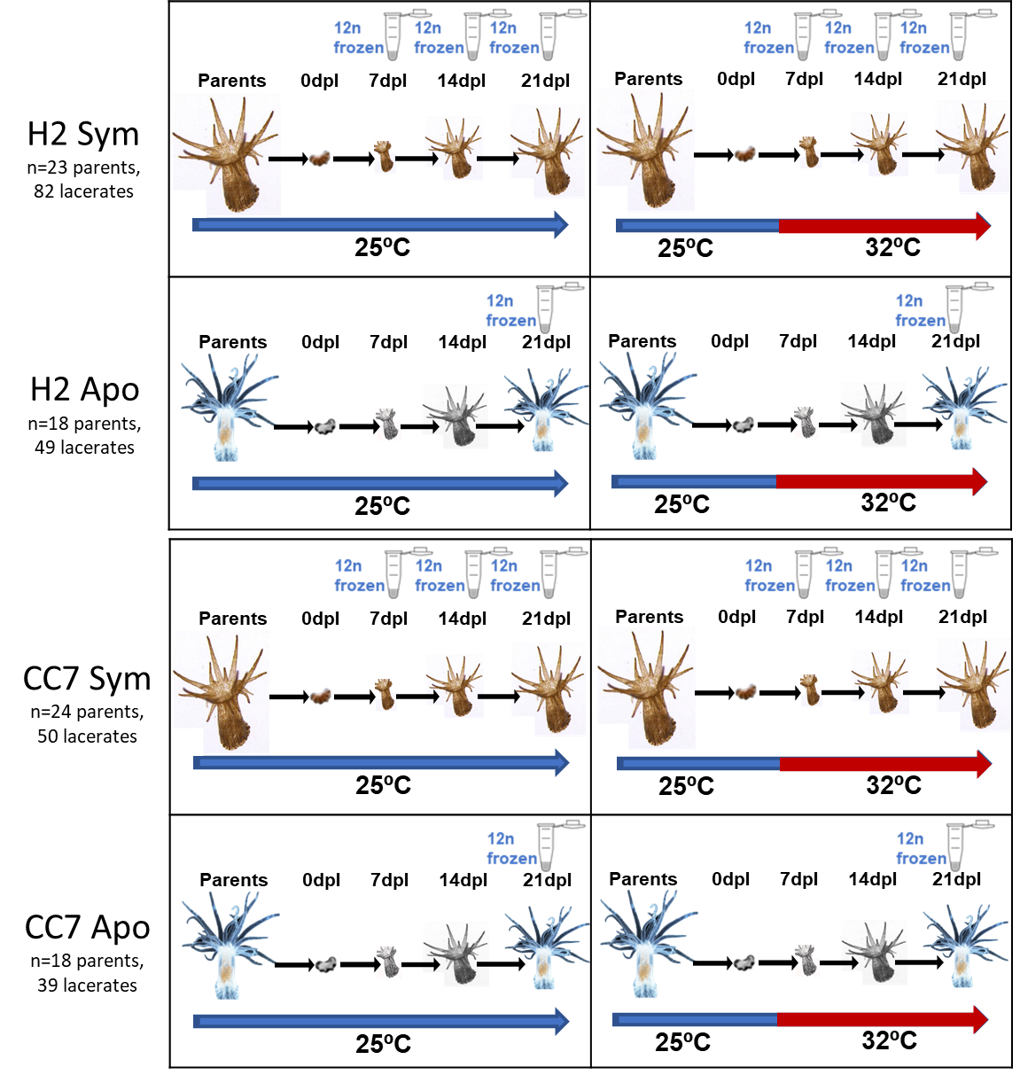
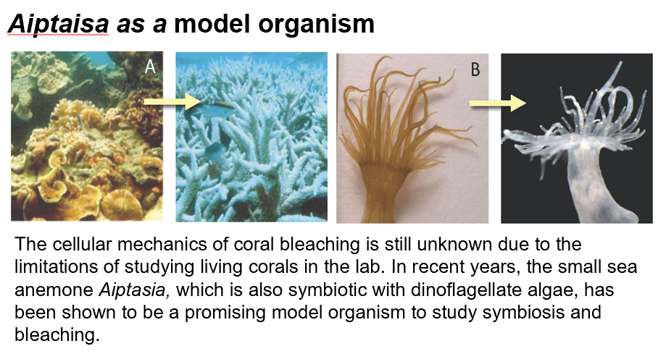
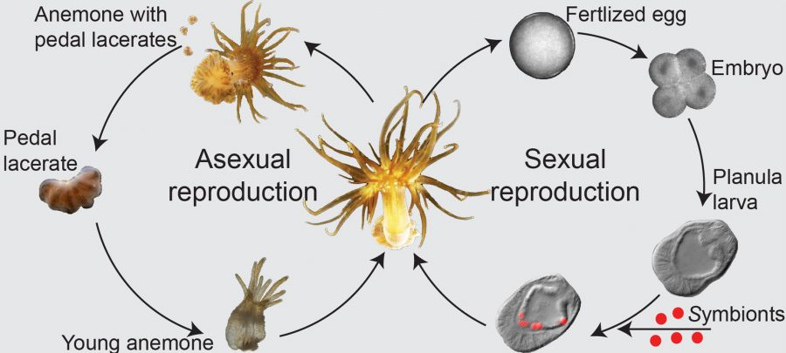

Project Summary
This project aims to understand the effects of environmental and inherited factors such as temperature, nutrition, genetic lines and symbiotic state in the early stages of development as measured by tentacle counts for the sea anemone, Aiptasia, a model system for the study of coral-algal symbiosis.

Slide 4
Project Summary
This project aims to understand the effects of environmental and inherited factors such as temperature, nutrition, genetic lines and symbiotic state in the early stages of development as measured by tentacle counts for the sea anemone, Aiptasia, a model system for the study of coral-algal symbiosis.

Slide 5
Project Summary
This project aims to understand the effects of environmental and inherited factors such as temperature, nutrition, genetic lines and symbiotic state in the early stages of development as measured by tentacle counts for the sea anemone, Aiptasia, a model system for the study of coral-algal symbiosis.

Slide 6
Project Summary
This project aims to understand the effects of environmental and inherited factors such as temperature, nutrition, genetic lines and symbiotic state in the early stages of development as measured by tentacle counts for the sea anemone, Aiptasia, a model system for the study of coral-algal symbiosis.

Slide 7
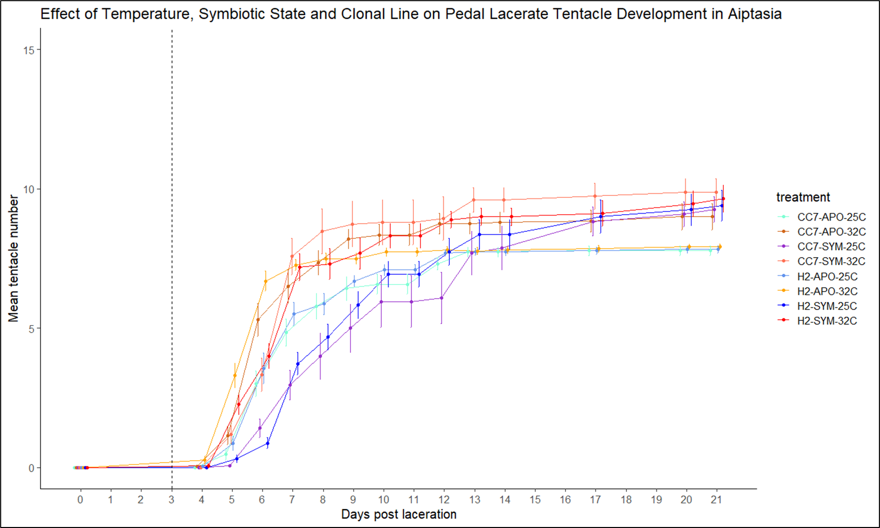
Project Goals
Data visualization
Linear modeling
Hypothesis testing for effects of treatments
Analysis of variance
Mixed effect modeling
Streamlining this process and make it reproducible

Slide 8
Goals for this quarter
Learning to use GitHub
Improve file management and organization
Streamlining data analysis
Creating reproducible data for collaboration

Slide 9
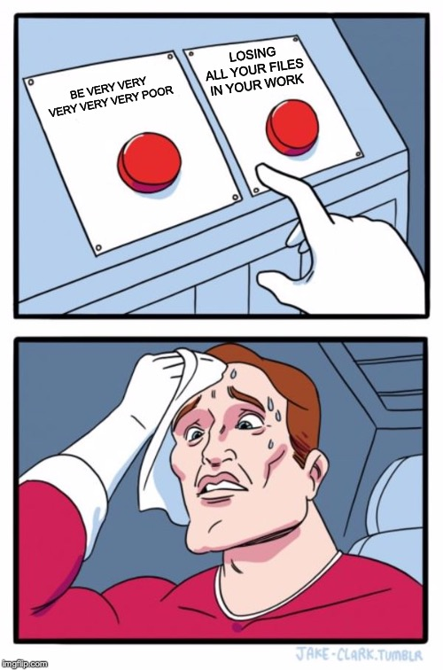
Challenges
Computer issues - Encoding issue with Rstudio basically erased all my codes and work from the summer
Important argument for GitHub for version control
Missing about a couple weeks of class because of travel

Slide 10
Success this quarter
Recreate results and graphical outputs
Improve file organization
Streamlining data analysis
Creating reproducibility
Streamlining this process and make it reproducible

Slide 11
Scientific insights achieved

Slide 12
Main sticking points and future plans

